Slide 1
Data Science II: Course Introduction
Spring 2025
Prof. Shannon Quinn

Slide 2
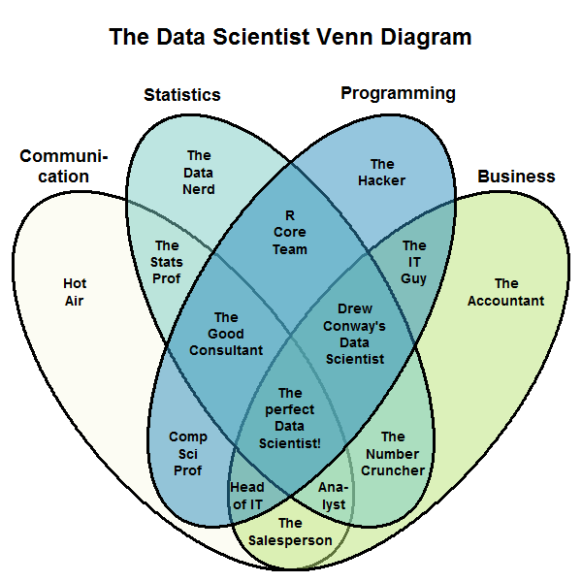
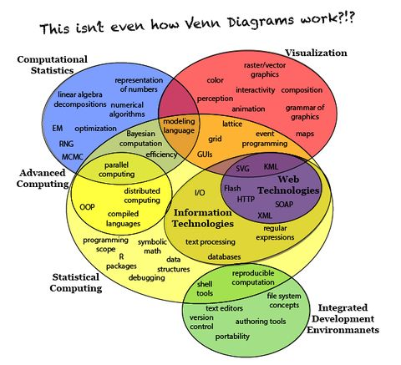

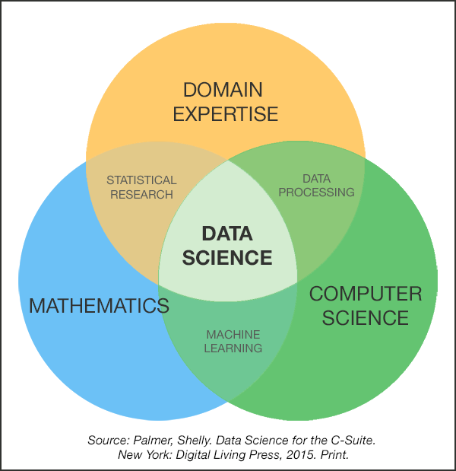
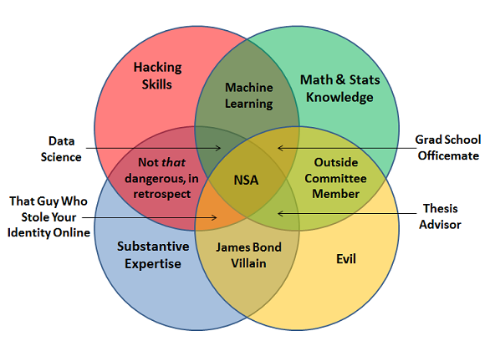
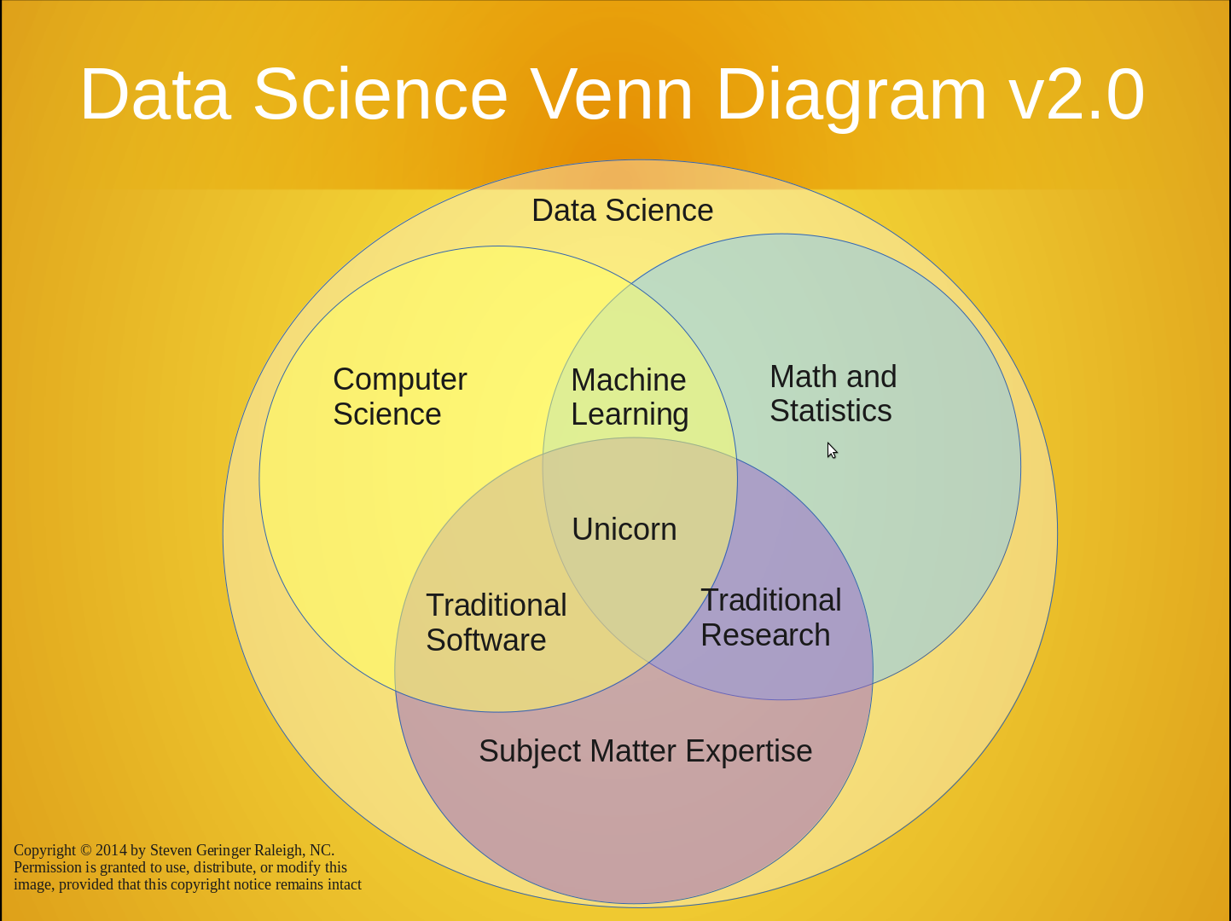
What is “data science”?
It’s a field singularly devoted to bringing back the Venn Diagram

Slide 3
What is “data science”?
From Wikipedia (emphasis mine):
Data science, also known as data-driven science, is an interdisciplinary field about scientific methods, processes, and systems to extract knowledge or insights from data in various forms, either structured or unstructured, similar to data mining. Data science is a "concept to unify statistics, data analysis and their related methods" in order to "understand and analyze actual phenomena" with data. It employs techniques and theories drawn from many fields within the broad areas of mathematics, statistics, information science, and computer science, in particular from the subdomains of machine learning, classification, cluster analysis, data mining, databases, and visualization.

Slide 4
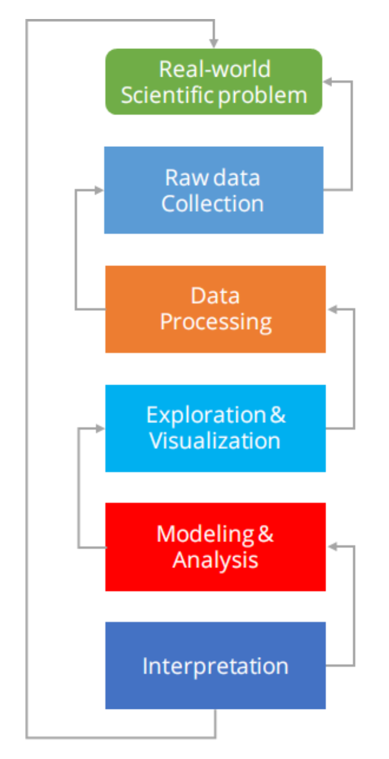
What is “data science”?
If you want my opinion: Dr. Lee nailed it in CSCI 3360
Data Science encompasses the entire problem stack
Problem definition
Data collection & cleaning
Exploration
Modeling
Interpretation & insights

Slide 5
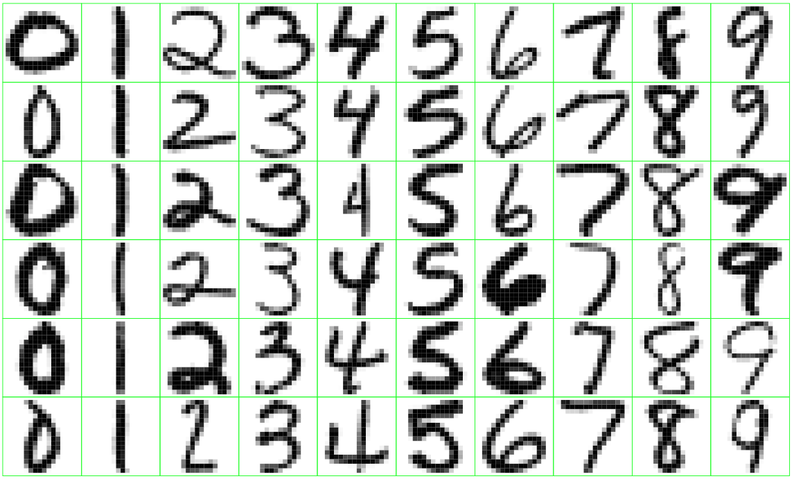
Data Science in practice
Can we automatically sort mail based on ZIP code?

Slide 6
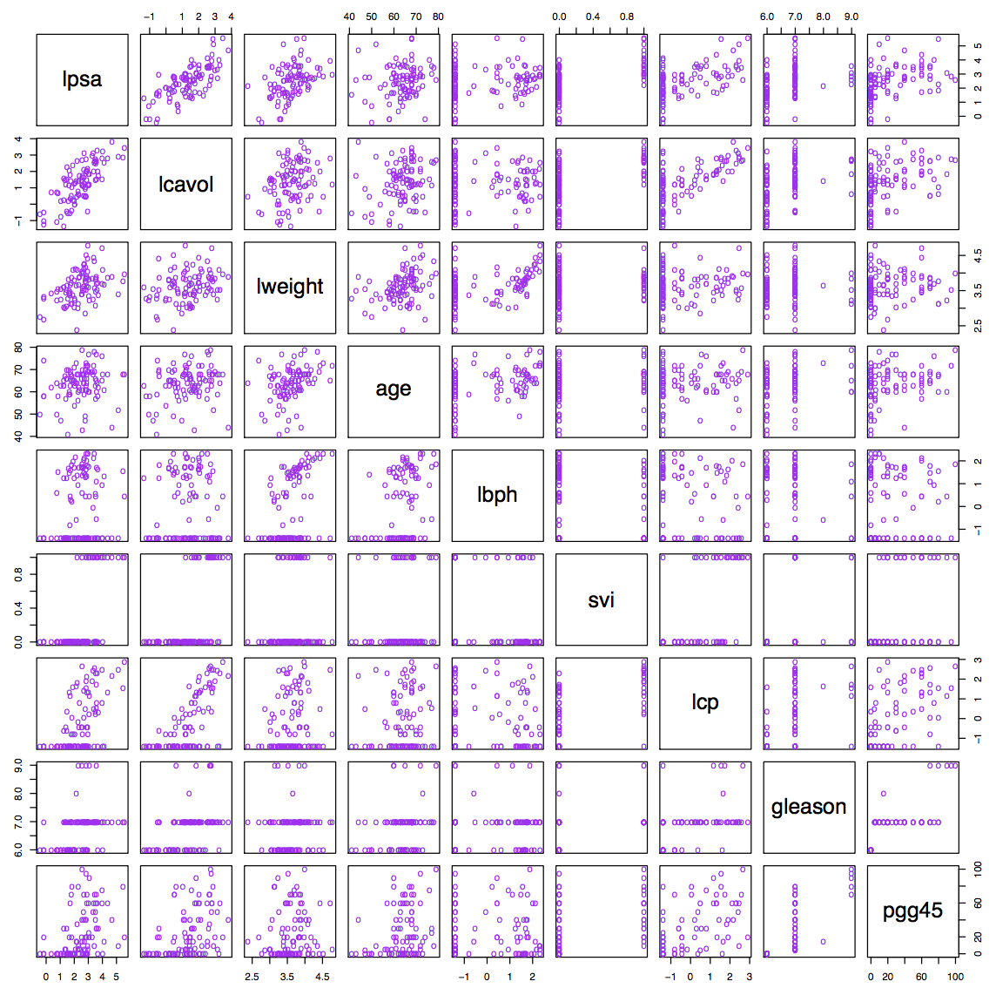
Data Science in practice
What features of prostate cancer are indicative of production of specific antigens?

Slide 7
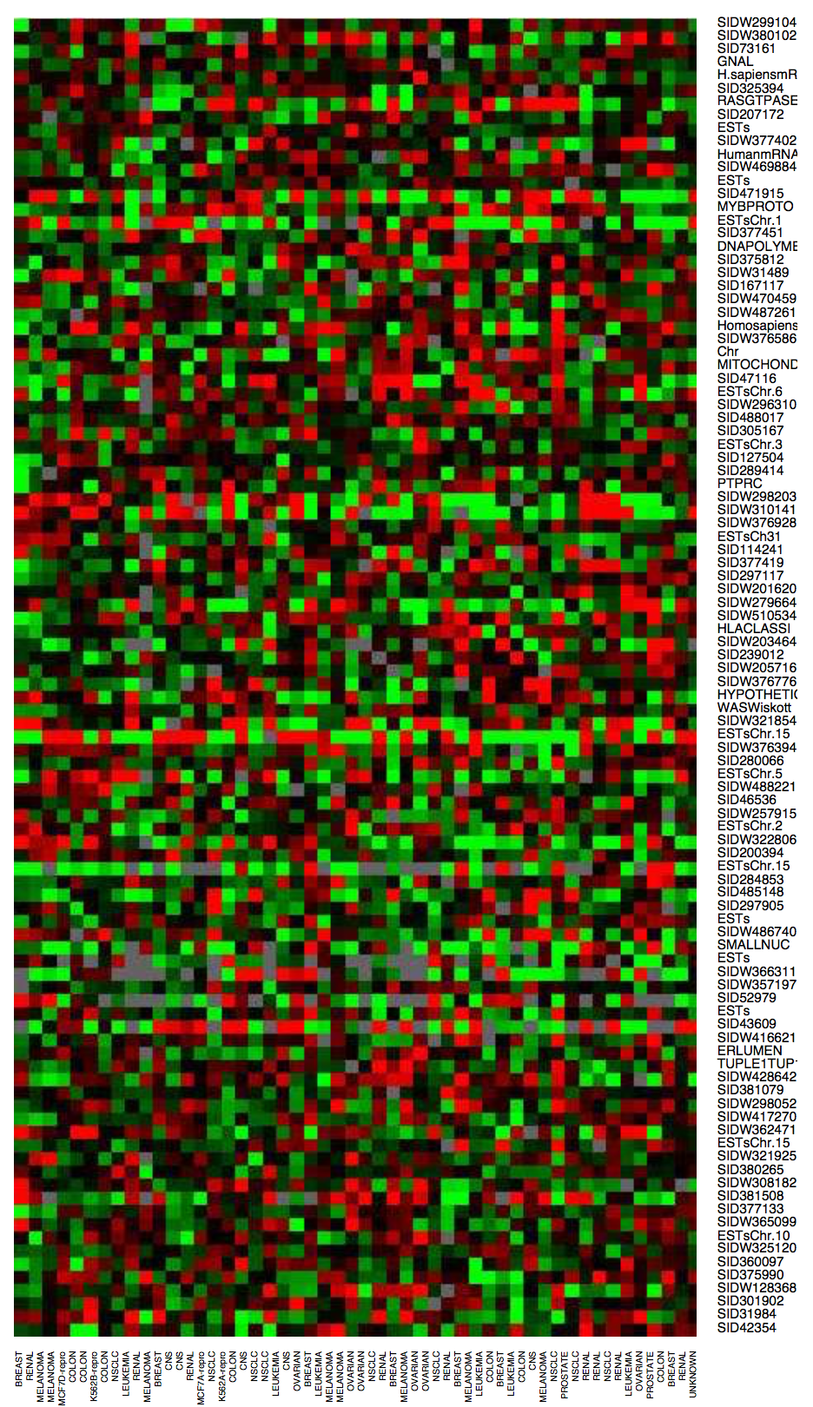
Data Science in practice
Which genes are overactive or underactive in cancer patients?

Slide 8
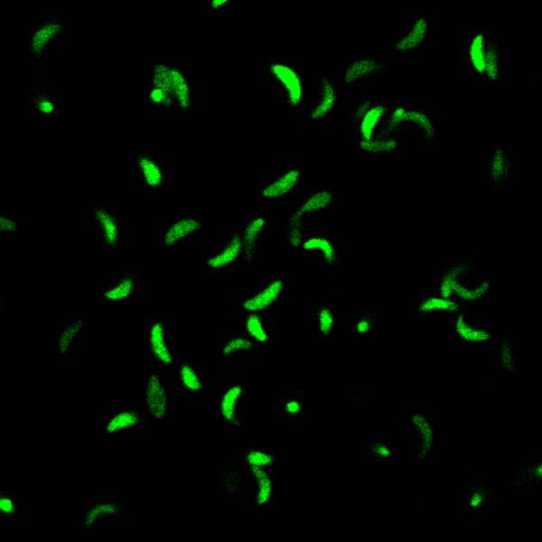
Data Science in practice
What factors determine the movement of the Toxoplasma gondii parasite?

Slide 9
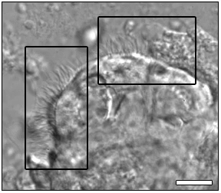
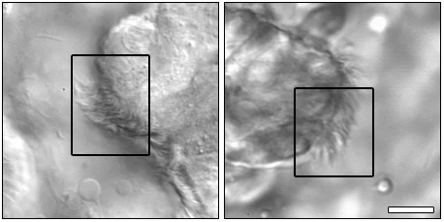
Data Science in practice
How is the motion of cilia associated with and indicative of specific pathologies?

Slide 10

Data Science in practice
What are the protein patterns of mitochondria under different conditions, and how do these changes take place?

Slide 11
Data Science in practice
Self-driving cars
Chatbots / Image generators
Product recommendations
Biometrics / facial recognition
Precision agriculture
Social media feeds
Graphics upscaling
Security camera intruder detection
[[ your application here ]]

Slide 12
Data Science in practice
It’s multi-disciplinary
At most one foot in Computer Science
It’s collaborative
Gone are the halcyon days of the “lone genius”
Teams are the norm
Communication is more important than ever
It’s humbling
There’s always something new to learn
There’s always someone with more expertise

Slide 13
What this course *is*
Picks up where 3360 Data Science I left off
A deeper dive into modeling and quantitative analysis methods
“What to do when you’ve already tried Option A”
Combination of theory and practice using latest data science tools and techniques

Slide 14
What this course is *not*
Recent (ie, ~2022) changes to CSCI 3360 have made this point problematic. Needless to say I’m aware DS1 no longer teaches much (if any) prob/stat/linalg, so we’ll take this one step at a time.
Introduction to probability and statistics
Should be able to derive Bayes’ Theorem from law of conditional probability, no sweat
Don’t need to prove the SVM dual, but should be aware of it and its function
Introduction to programming
No Python experience required, but are expected to pick it up FAST (i.e., you’ve programmed before, just not in Python)
Lecture 2 is a Python crash-course, Workshop 0 is hands-on
Deep Learning 101
Yes, we will cover deep learning toward the end
There is a LOT more to data science than throwing a ResNet at it

Slide 15
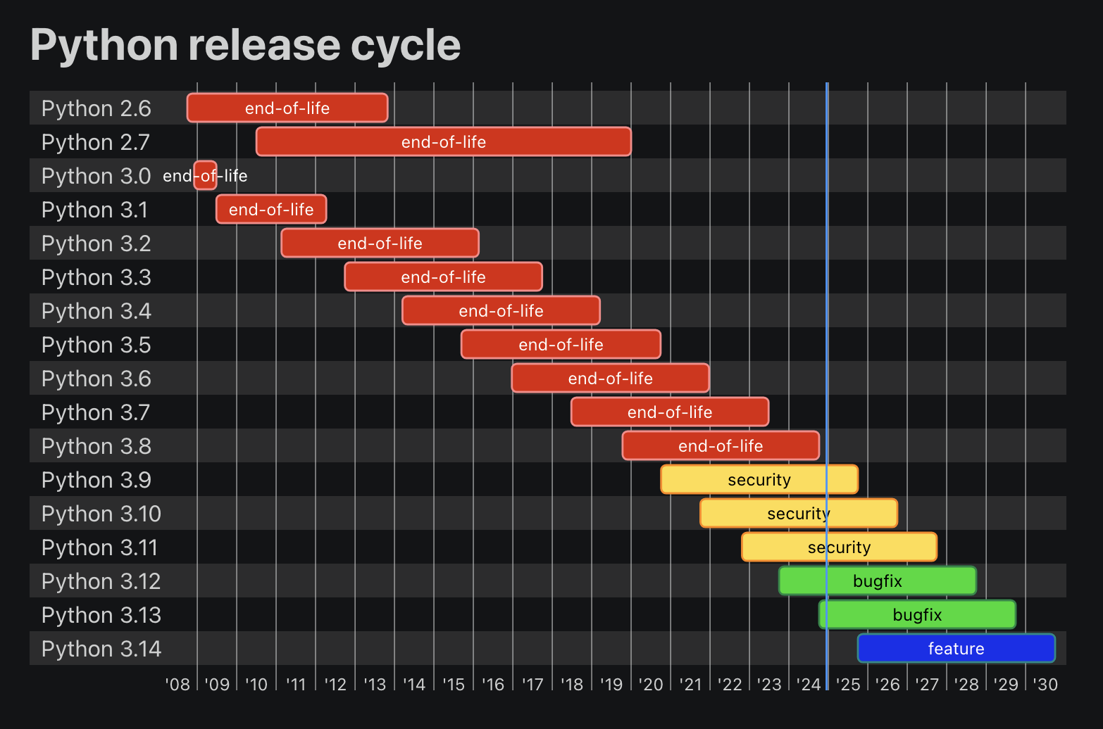
What?
Course title: Data Science II
CSCI 4360 (for undergraduates)
CSCI 6360 (for graduates)
Course textbooks: none required
Lots of recommended books—check out the course website
Will continue to update with more references
Python: 3.10 – 3.12
Absolutely no earlier than 3.9
https://devguide.python.org/versions/

Slide 16
Who?
Prof. Shannon Quinn (that’s me)
2008: B.S. in Computer Science from Georgia Tech (go Jackets!)
2010: M.S. in Computational Biology from Carnegie Mellon
2014: Ph.D. in Computational Biology from joint Carnegie Mellon-University of Pittsburgh Ph.D. Program in Computational Biology
Started at UGA in January 2015
Research areas
Biomedical imaging
Computer vision
Distributed computing
Representation learning
Spatial Biology

Slide 17
When and Where?
Lectures
Tuesdays and Thursdays: 2:20 – 3:35pm, Journalism 0501 (here!)
Workshops
Wednesdays: 3:00 – 3:50pm, Dawson Hall 0310
Office Hours
Discord (aka virtual)
Tuesdays, 1:00 – 2:00pm
Thursdays, 12:00 – 1:00pm
Or by appointment
TA: TBD
Will announce when they have been assigned

Slide 18
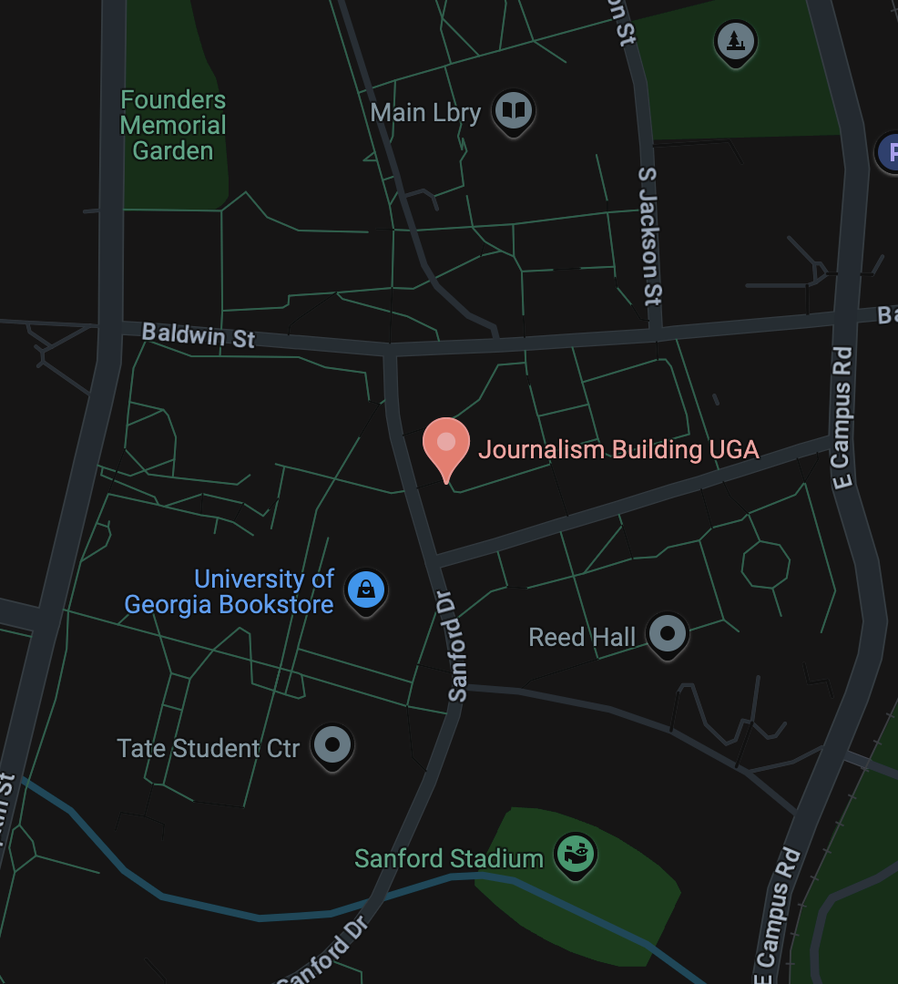
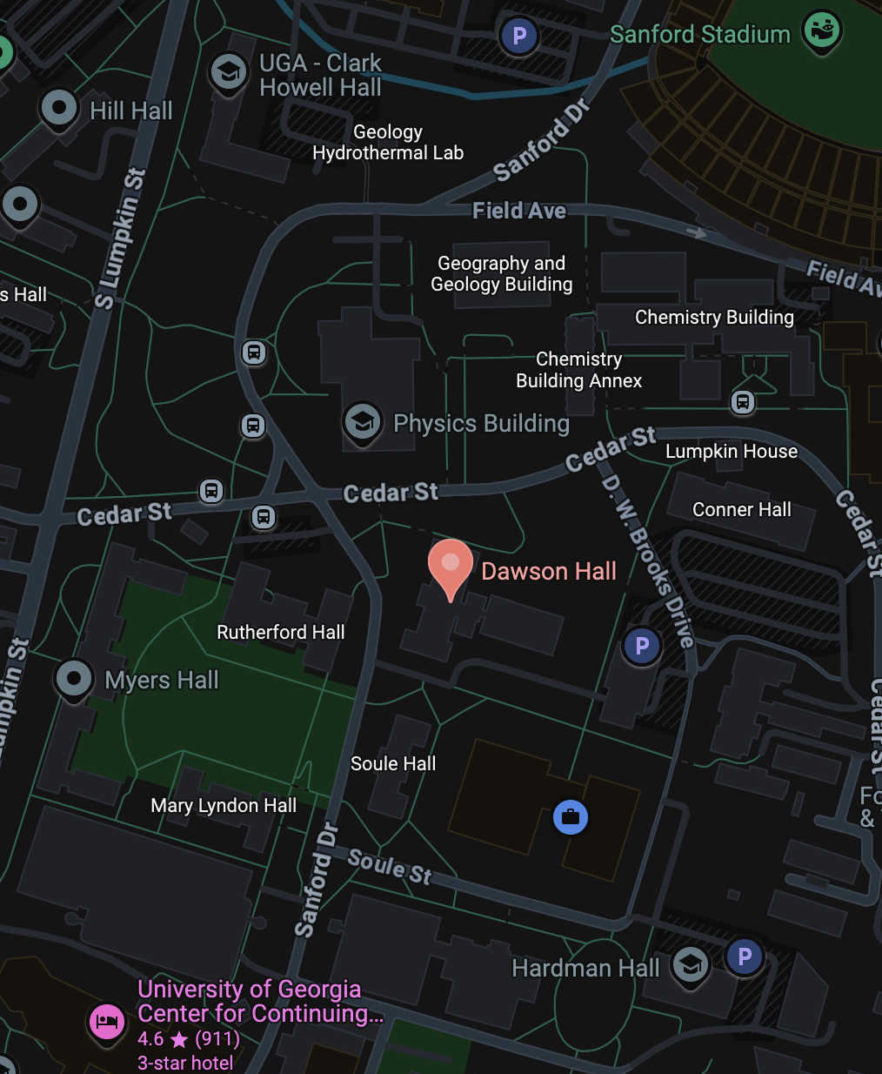
When and Where?
Tuesday / Thursday
Wednesday

Slide 19

How?
Course website / syllabus: https://eds-uga.github.io/csci-x360-sp25/

Slide 20

How?

Slide 21
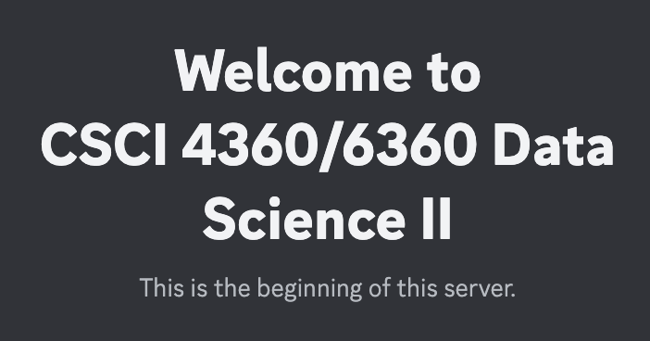
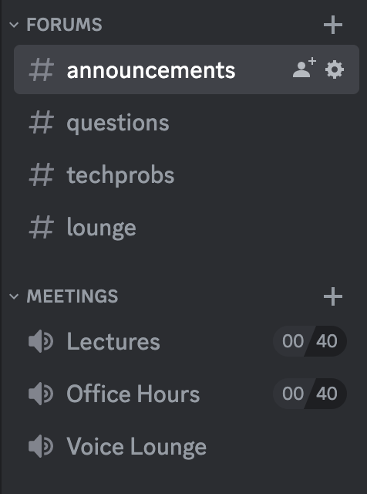
How?
Discord server

Slide 22
How?
Discord: post in #questions
Email: squinn@cs.uga.edu
I get tons of emails every day
Discord will not only likely get a faster response, but your fellow students could probably also answer even more quickly

Slide 23
Honesty at UGA
I’d like to think I don’t have to justify this
There’s an official UGA Honesty Policy https://ovpi.uga.edu/academic-honesty/academic-honesty-policy
AutoLab has a code-checker built in
It’s way easier than you think to spot copied code
The official policy in this class: Discuss ideas and concepts with your classmates (or anyone!). Write the code yourself (unless you’re on a team).

Slide 24
Honesty at UGA A note on chatbots
We’ll cover the technical aspects of chatbots toward the end of the course, so stay tuned
Use of chatbots to help in your assignments is not prohibited… per se
I can’t really stop you
But these aren’t exactly a panacea if you don’t understand something
Like any other external source, cite your use of chatbots (or collaboration with anyone else) in your assignment write-ups
I’ve worked with generative text models for 15+ years (before they were cool)
They’re pretty cool… but they have distinctive “tells”

Slide 25
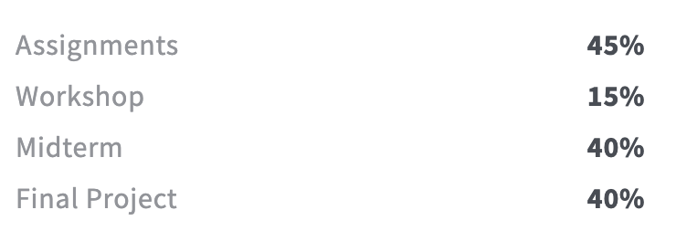
Grading Breakdown

Slide 26
Assignments
There will be 5. You are required to complete 3.
So yes, each is worth 15% of your grade
Any more than 3 will be extra credit
Each will be 2.5 weeks long
Released on a Thursday afternoon
Due on a Tuesday 2.5 weeks later by 11:59:59pm
Will entail a written and a programming portion
Coding in Python
Writing in Word or LaTeX—nothing handwritten!
All deliverables will be submitted through AutoLab

Slide 27
Workshops
Most Wednesdays, we’ll have a workshop
This is student-led and organized
Everyone is required to do one (teams of 2-3 is fine, even necessary)
Any more is extra credit (only available once all required slots have been taken)
The objective of each workshop is to demo a proof-of-concept for your student colleagues
Should be in the 20-35 minute range
This can be
implementing a topic we covered in class
demonstrating how to use a tool that would help with the topics we’re covering
some other neat course-related use-case
Recommended topics are on the course website!

Slide 28
Midterm exam
It’s an exam that happens near the mid-term (Feb 27), what more do you want?
(details will be released later)
Biggest take-away: you can do EITHER the midterm OR the final project
Doing both is extra credit

Slide 29
Final Project
Teams (of 2-3 students, ideally) will work on a specific data science question
Three components:
The proposal, which outlines the team you’ll work with, the question you’ll address, and the methods + tools you’ll use to address it
Two updates, one-page deliverables that lay out 1) what your team has accomplished so far, 2) obstacles you have encountered and how you plan to work around them, and 3) any deviations you anticipate from your proposal
The presentation, where you talk about how awesome your problem is and how you and your team killed it dead (or have almost done so)
More details to come!

Slide 30
“Assignment 0”
Accept the invitation to Discord if you haven’t already
Or ping me if you haven’t received any such invitation
The Discord is only for registered students
Put together groups of 2-3 students and pick a date + topic for a workshop (see the course website for available dates)
First [student-run] workshop is Wednesday, Jan 15!
Sign up here: https://docs.google.com/spreadsheets/d/1S9fuFx47iEiB5z0grZURiRu7aBYdiB3bGUPmob25zyw/edit#gid=0
Register an account on AutoLab
https://autolab.cs.uga.edu
Then let me know (e.g., ping me in Discord) so I can add you to the course

Slide 31
Assignment 1
Coming out Thursday (Jan 9)
Machine Learning review
Do you remember probability and statistics?
Do you remember linear algebra?
Do some coding, interact with AutoLab, submit a write-up
Due Tuesday, January 28

Slide 32
Tomorrow
Workshop 0, on using the Anaconda distribution for installing and configuring your own Python environment! (far and away the easiest way to get up and running with Python)

Slide 33
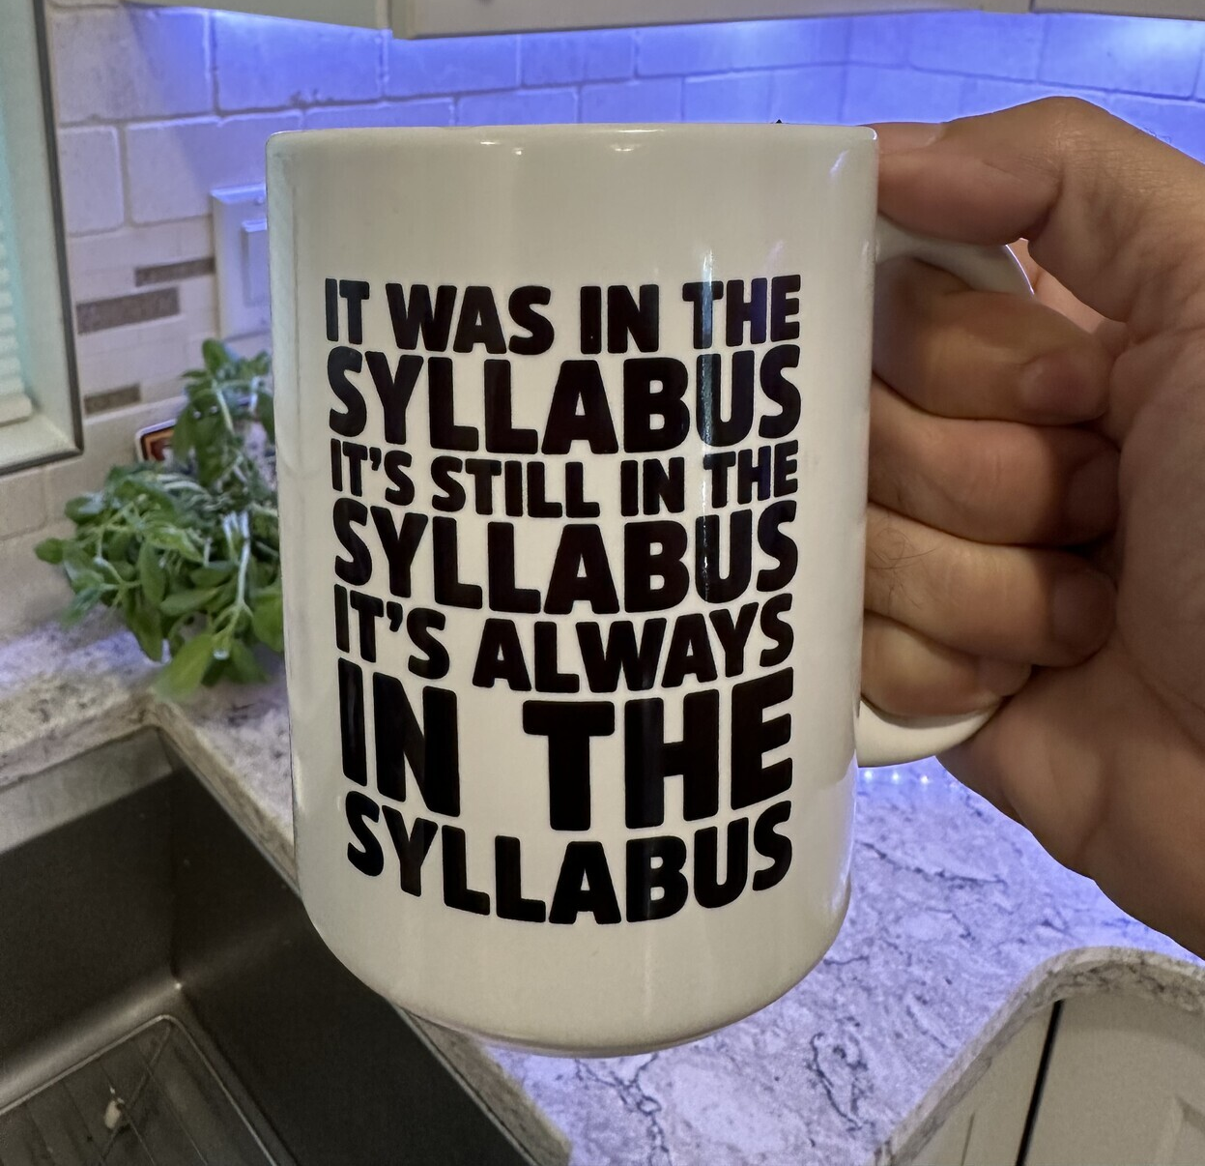
Final thoughts

Slide 34
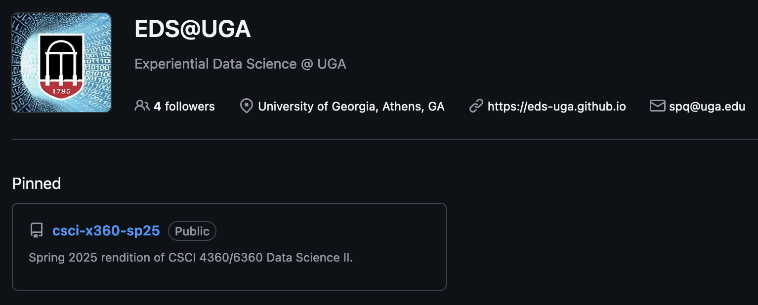
Final thoughts
If in doubt, go to: github.com/eds-uga
Click the pinned repo

Slide 35
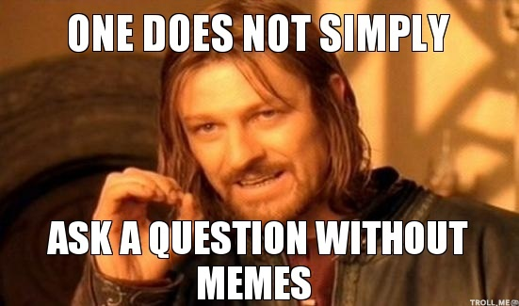
Questions?

Slide 37

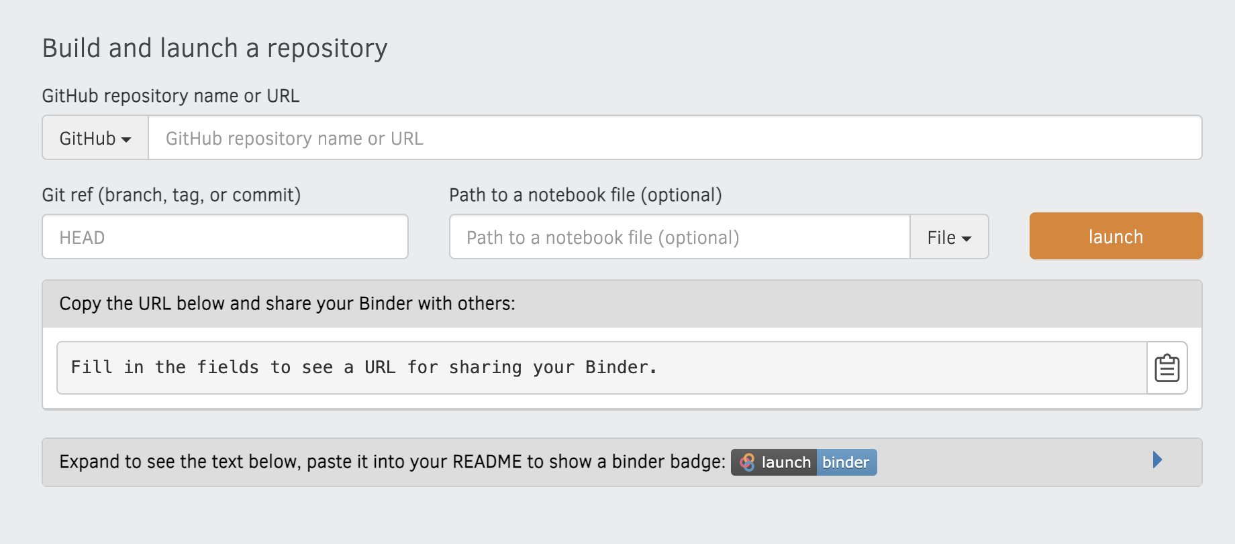
BinderHub
Set up a prototype BinderHub instance for stress testing
The technology behind mybinder.org
Put your Jupyter notebook[s] in a [public] GitHub repo
Specify the environment (environment.yml, requirements.txt)
Submit the link to your GitHub repo
Learn more here https://mybinder.readthedocs.io/en/latest/

Slide 38
BinderHub
https://hub.binder.ltg.cs.uga.edu/
Great for testing your programs in an isolated and replicable environment
Even better if your laptop isn’t up to running Python
Takes a very long time to build environments (~30 minutes)
No GPU access
Send me feedback on your experience with it! We’re wondering if this would be something useful for the whole campus.

